Slide 1

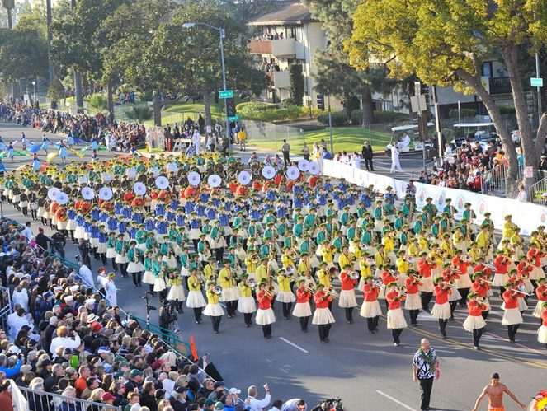
Design and Testing II
Proclaims
Angel Delgado Luna

Slide 2
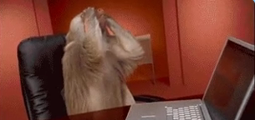
Addenda – Workaround Do you remember last week when chapters edition failed?

Slide 3
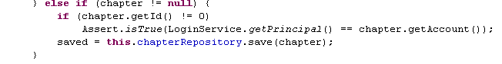
Problem
Have a look to this assert. Something does not work properly. When an actor is edited, his/her account can also be modified.

Slide 4

Oh… Ok. I want to modify my account but I don´t want anyone has the possibility to modify my data by hacking… What can I do?

Slide 5
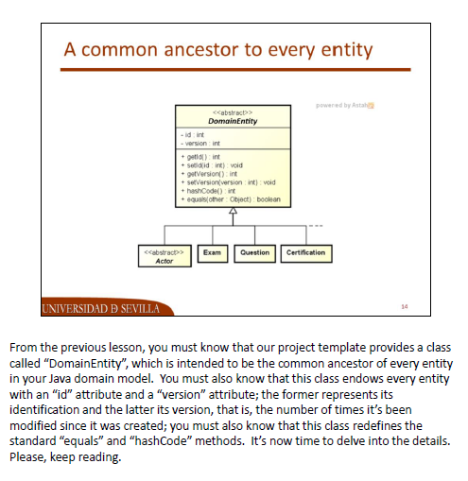
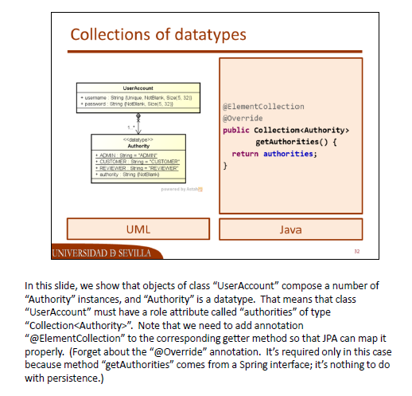
Let´s make a workaround

Slide 6

Now Let´s begin with our real problem Chapters can create, edit, list and delete proclaims
Before we start… What is a proclaim?

Slide 7
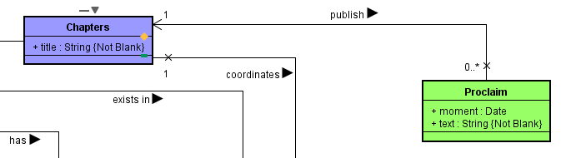
Domain Model - UML

Slide 8
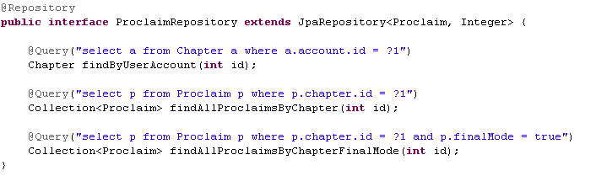
Repository

Slide 9
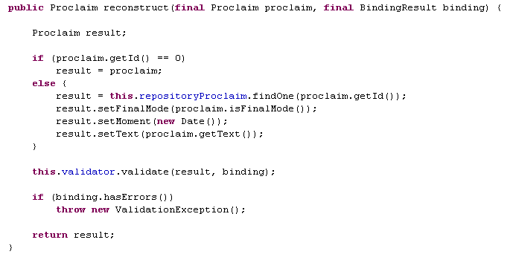
Service - Reconstruct

Slide 10
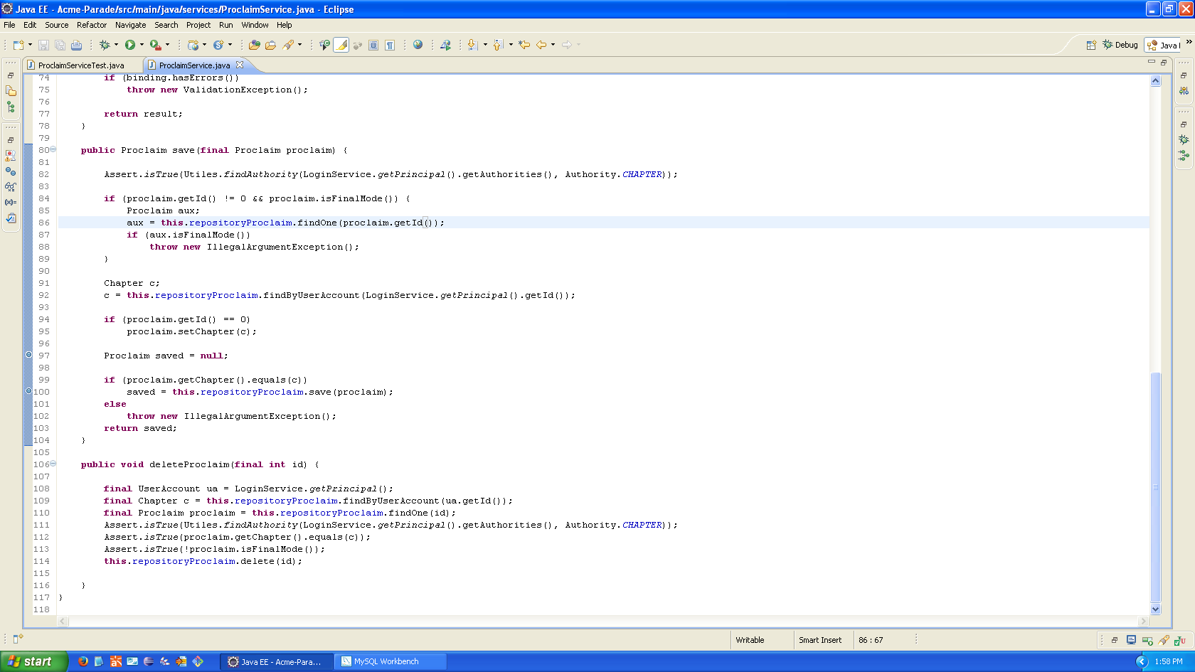
Service - Save

Slide 11
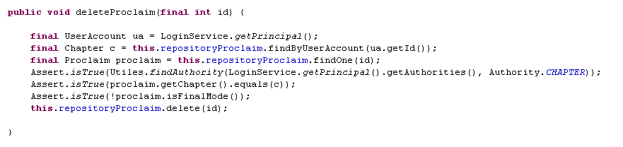
Service - Delete

Slide 12
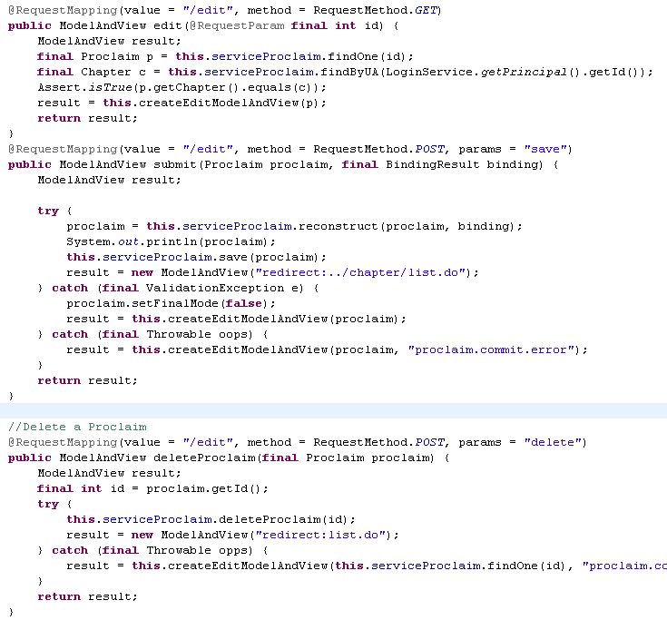
Controller

Slide 13
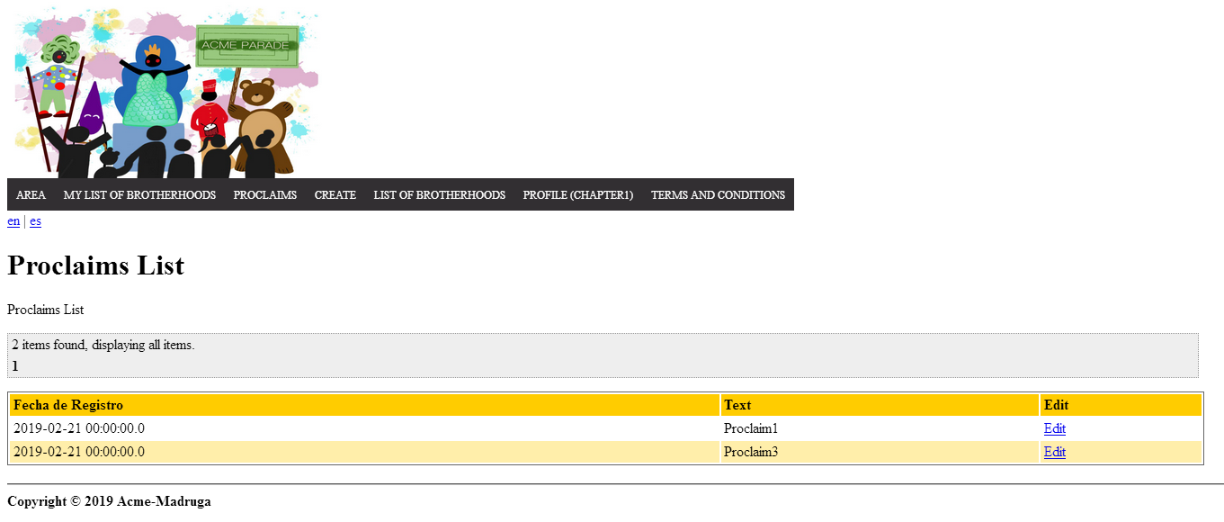
Views - List

Slide 14
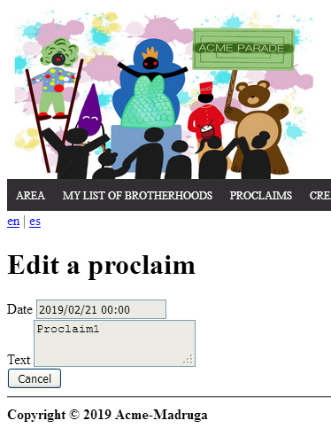

Views - Edit

Slide 15

Hacking Testing XSS

Slide 16
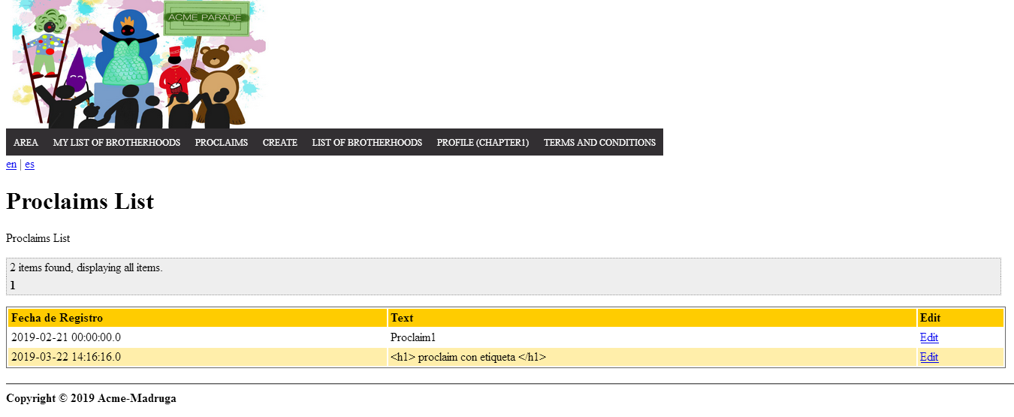
Hacking URL Post Hacking

Slide 17
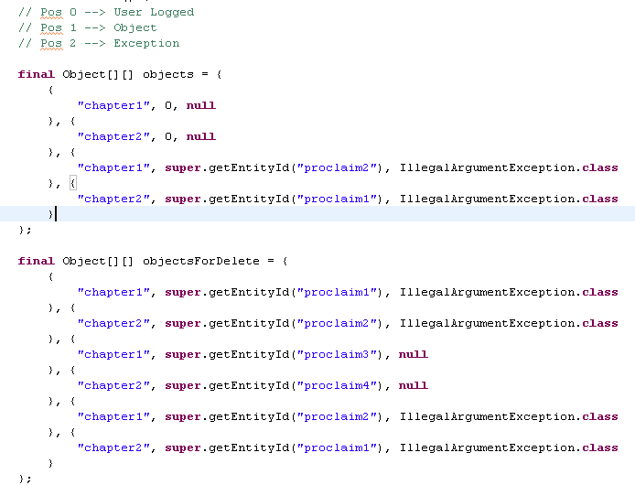
Functional Testing - Driver
3 parameters
1 Exception
Two chapters
Creation Tests
Editing a test is not mine
Deleting proclaims whose mode is final
Deleting proclaims whose owner is not the one logged
Deleting proclaims whose mode is draft

Slide 18
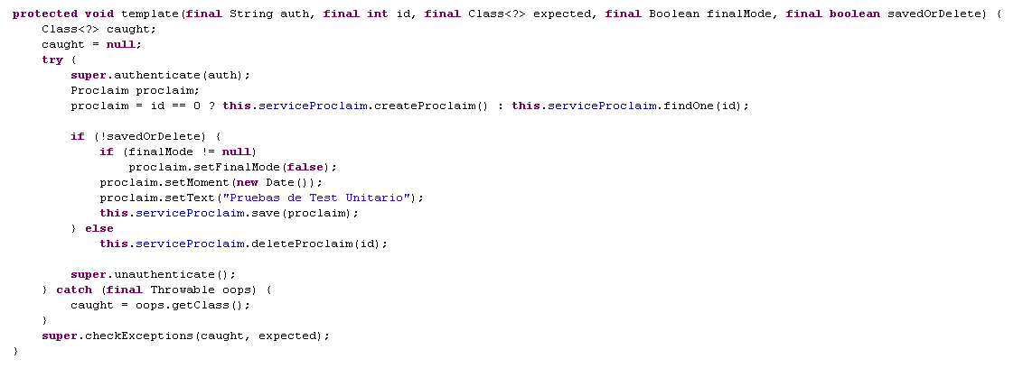
Functional Testing - Template

Slide 19
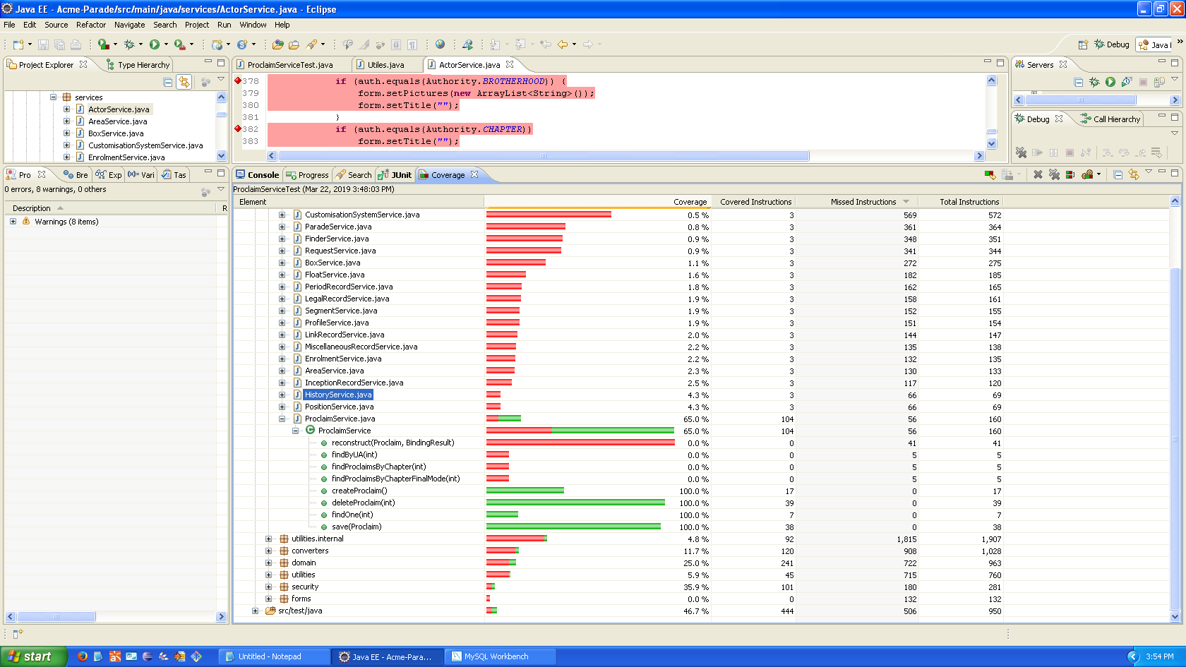
Functional Testing - Coverage

Slide 20
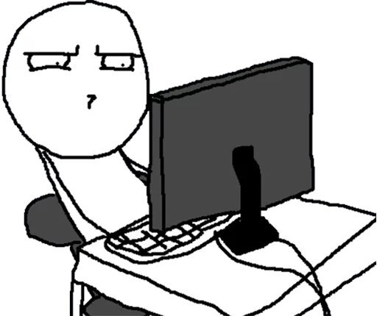
Questions? Thanks for your attention!

